Slide 1


Runtime Terror
COER University / College Of Smart Computing Table No. CB-3

Slide 2
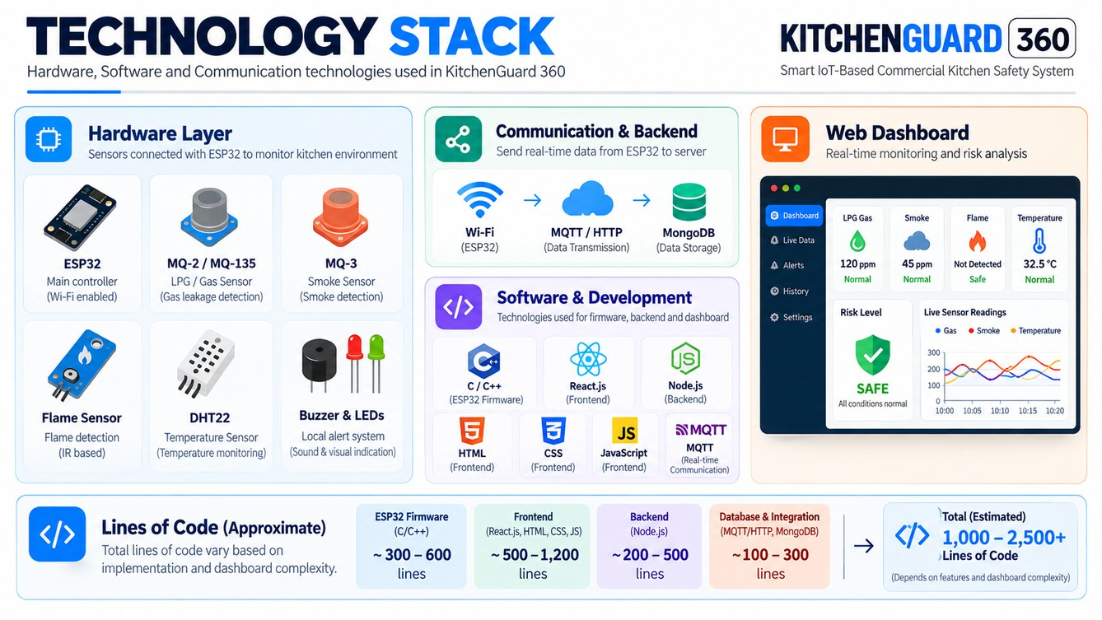
Problem Statement :-KitchenGuard 360
Commercial kitchens face safety risks such as LPG gas leakage, fire outbreaks, smoke, and abnormal temperature increases. Traditional safety methods may not provide continuous monitoring or timely alerts, potentially delaying emergency responses. KitchenGuard 360 aims to solve this problem by using an ESP32 microcontroller and gas, smoke, flame, and temperature sensors to monitor kitchen conditions in real time. A centralized web dashboard displays sensor readings, identifies risk levels, and generates alerts to help prevent accidents and improve kitchen safety .

Slide 3
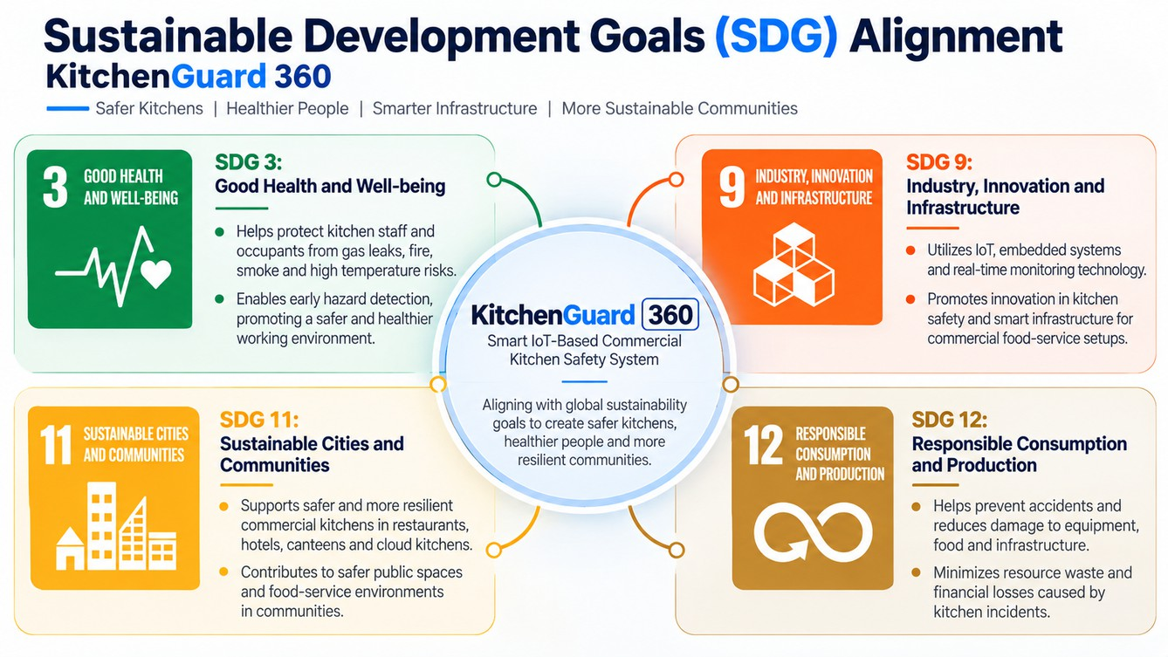
SDG 3: Protects lives and promotes health through early hazard detection
SDG
Alignment: KitchenGuard 360
SDG 9: Encourages IoT-based innovation in kitchen safety SDG 11: Supports safer commercial kitchen environments.
SDG 12: Helps reduce resource waste and damage caused by kitchen accidents.

Slide 4
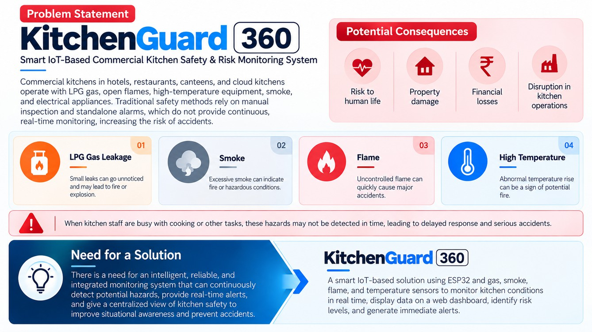
Technology Used: ESP32, LPG/Gas Sensor, Smoke Sensor, Flame Sensor, Temperature Sensor, C/C++, React.js, HTML, CSS, JavaScript, Node.js, MQTT/HTTP, and MongoDB.
Technology / Line of Code
Lines of Code (Estimated): 1,000–2,500+ lines, depending on the implementation and dashboard complexity.

Slide 5
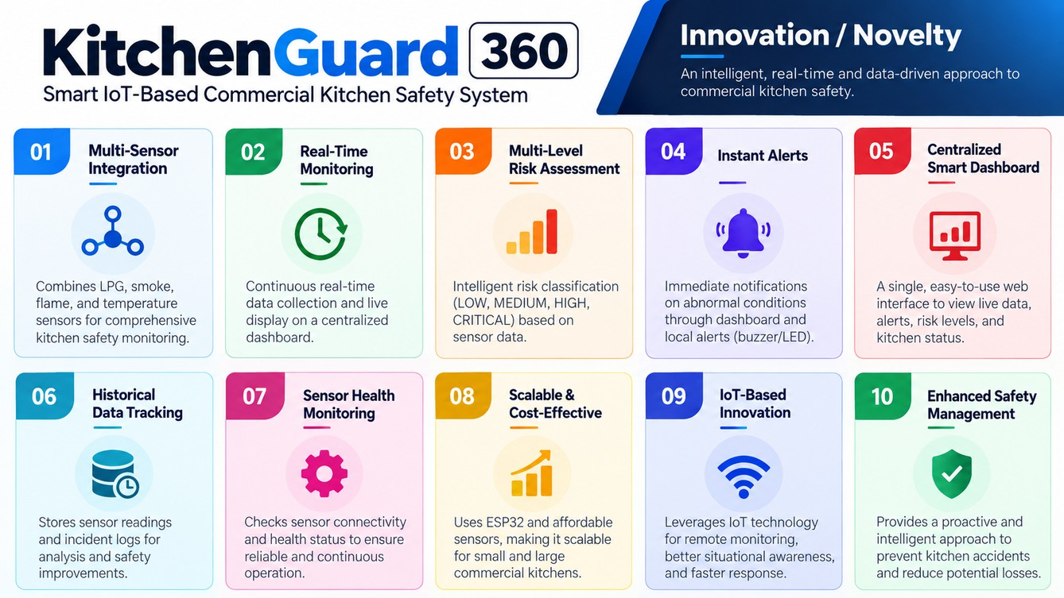
Innovation / Novelty: KitchenGuard 360
KitchenGuard 360 integrates multiple IoT sensors with an ESP32 to monitor LPG leakage, smoke, flame, and temperature in real time. Its key innovation is a centralized smart dashboard with multi-level risk assessment, instant alerts, sensor-health monitoring, and historical data tracking, enabling early hazard detection and improved safety management in commercial kitchens.

Slide 6
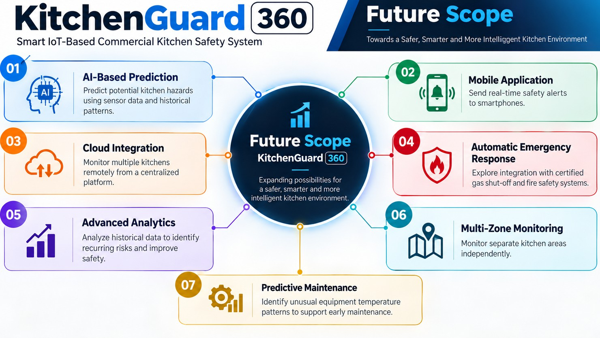
Future Scope

Slide 7
Thank
You

